Slide 1

VISHWAKARMA INSTITUTE OF TECHNOLOGY,PUNE
Department of Multidisciplinary Engineering (SY Common)
Date : 21 August, 2021
Software Development Project
(End-Sem Review)
Topic :
Dashboard Menu Design
Student’s Name : Sonawane Pushkar Mukesh
Class : SYDA – B
Roll No. : 53
Gr. No. : 12020116
Guided By : Prof. R. T. Akolkar

Slide 2
Problem Statement:
To design a dashboard containing the detailed information of the students at institute level.
Current scenario:
Such dashboards are available now a days but, in this project, slight modifications are done comparing to those students dashboards.
Need of Project:
This is a Software Development Project done at institute level. It can be used practically in future after slight modifications and customization. The information of students can be easily accessible and it is secured.

Slide 3
Introduction:
‘Dashboard Menu Design’ is the design of dashboard for student as well as institute use. This project includes the dashboard which will contain all the necessary information about the student. The dashboard will contain the tab named Classes which will show all the information about the timetable of the particular class of the students. The next tab is General info. This tab contains the basic information about the student such as address, contact info, family background, skills, educational status, personal information, etc. This can be updated in the course of time. Notifications named tab is the next tab which intimates the user about the task to be done. The visualization of this dashboard on various devices such as mobiles of different brands or desktops can be done using chrome browser.

Slide 4
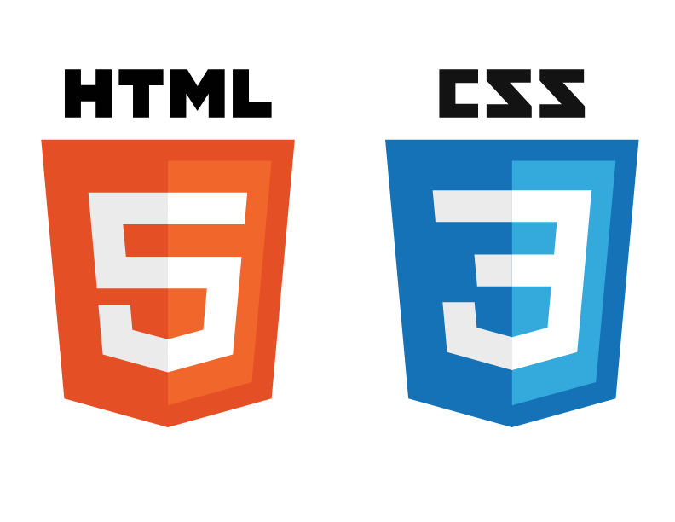




Technology Used:
Hyper Text Markup Language (HTML)
JavaScript
Cascading Style Sheet (CSS)
GitHub for Hosting
Google Chrome Browser
IDE – Visual Code Studio (VCS)
Source :
25 HTML & CSS Tutorials. Learn HTML & CSS by exploring these 25… | by Brandon Morelli | codeburst

Slide 5
Unified Modeling Language (UML) Diagram :
Registration to Courses
Information about classes
Time table for students
Students
Dashboard
Messages from faculties
Institute
Teachers
Important documents
Queries can be asked
Project Information
Assignments and Timetable

Slide 6
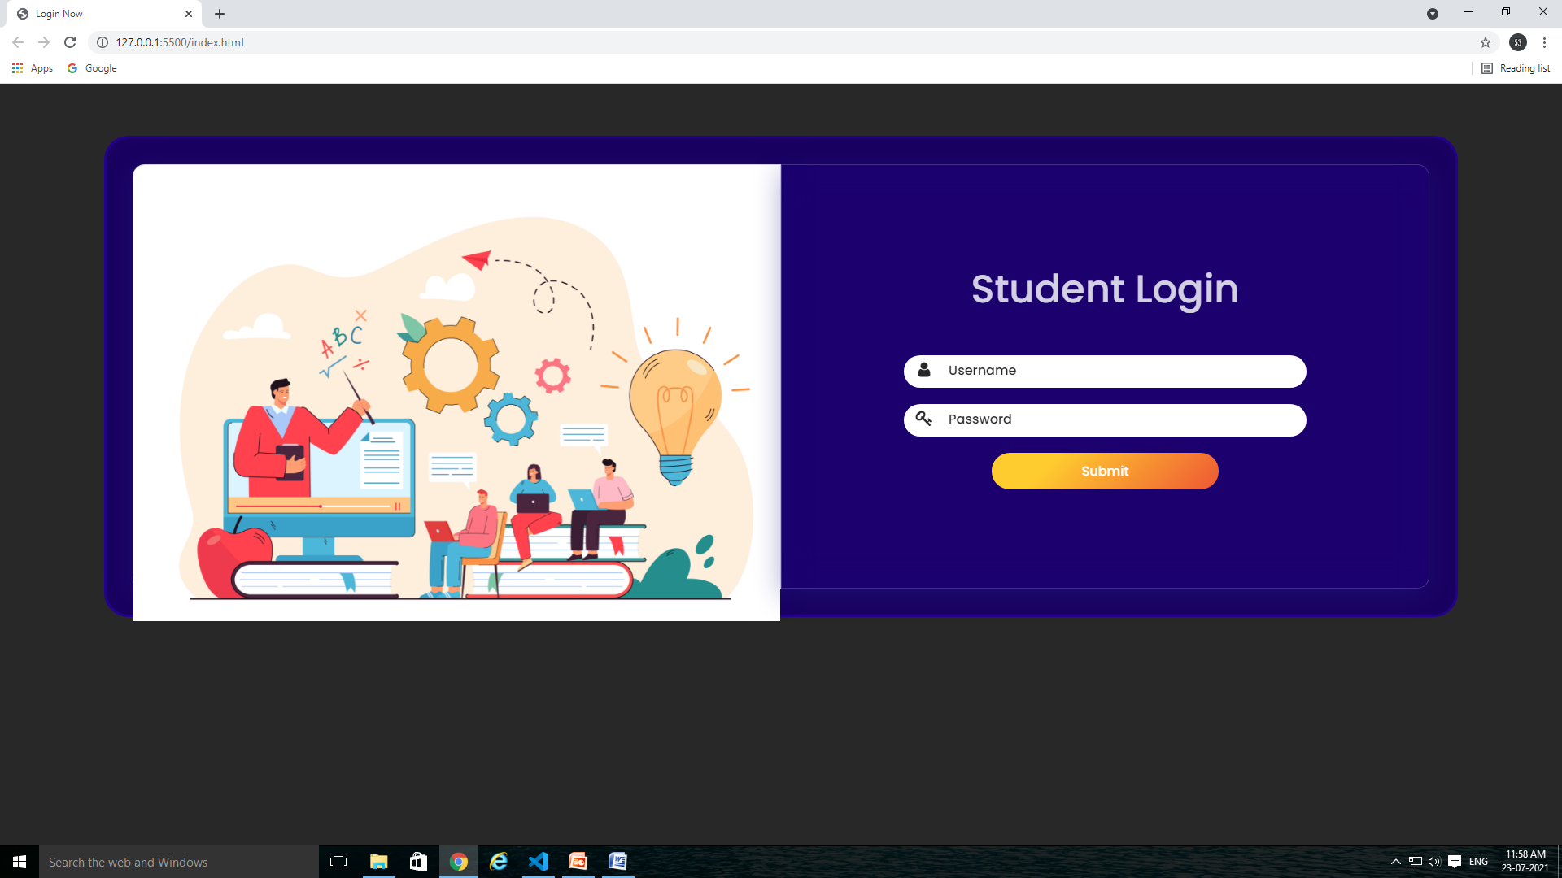
Dashboard:
Preview on Desktop/ Laptop

Slide 7
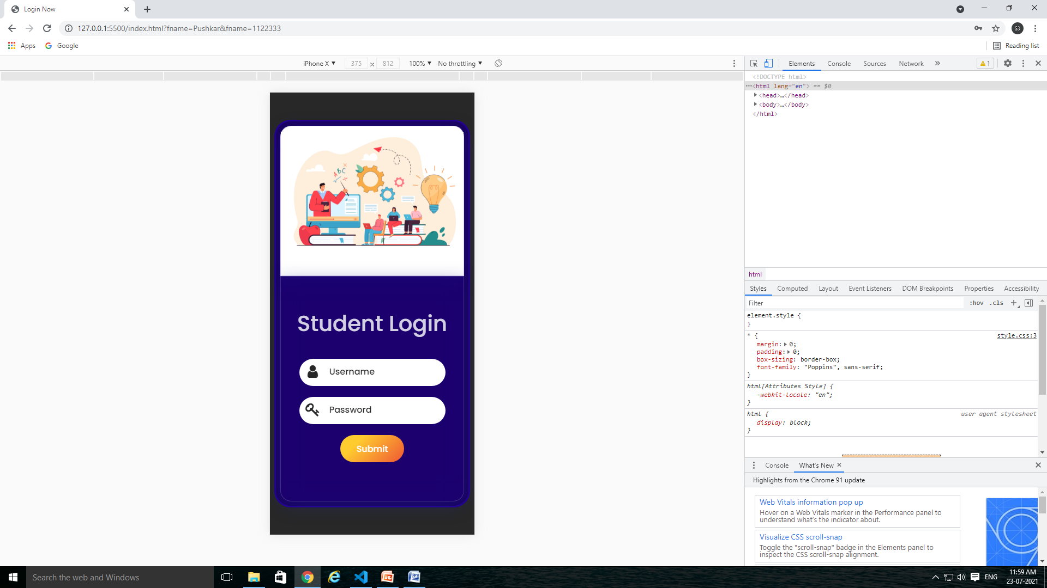
Preview on Mobile/Handset

Slide 8
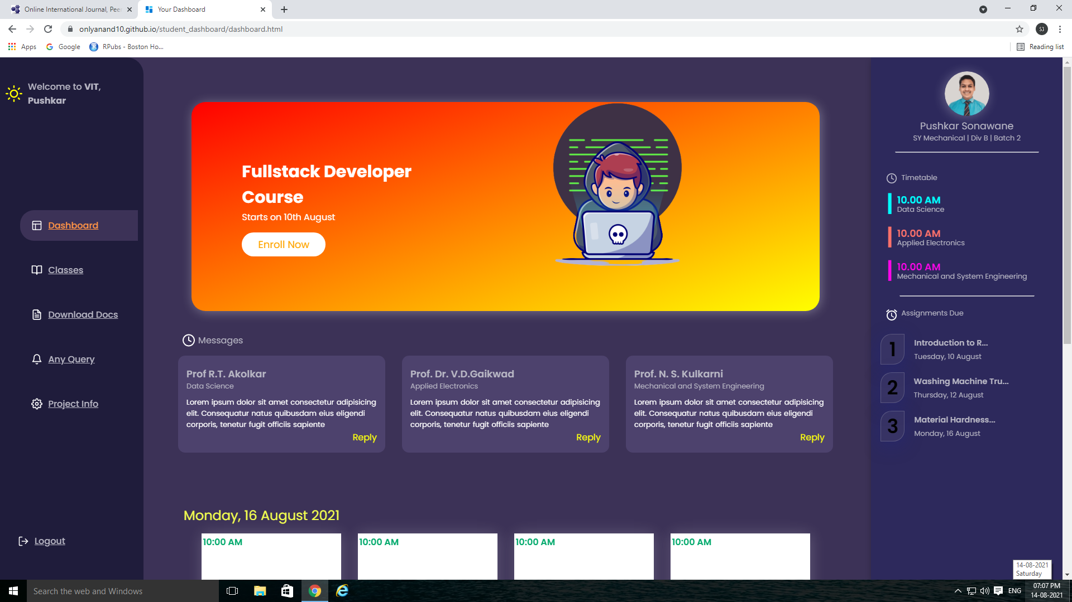
Upcoming
Classes
Navigation Tabs
Upcoming
Assignments

Slide 9
Dashboard and Navigation Tabs :

Slide 10
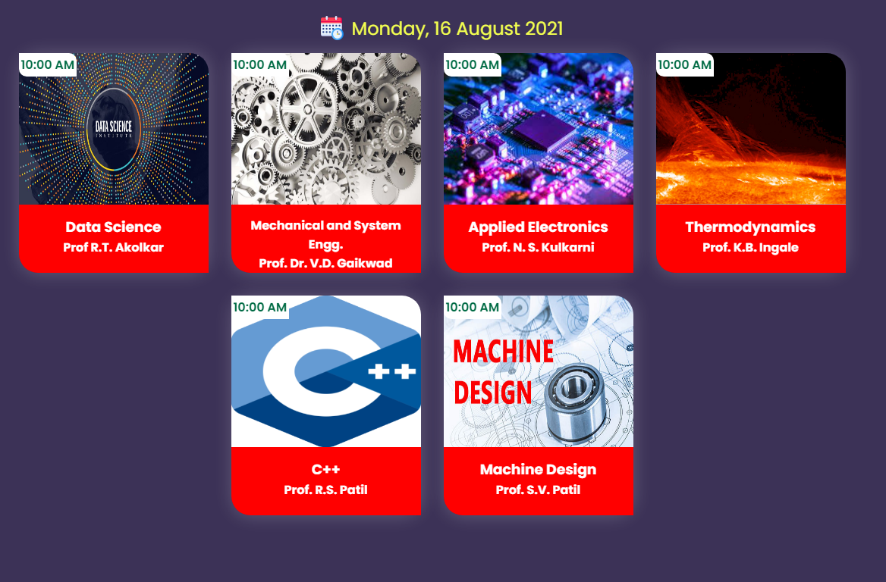
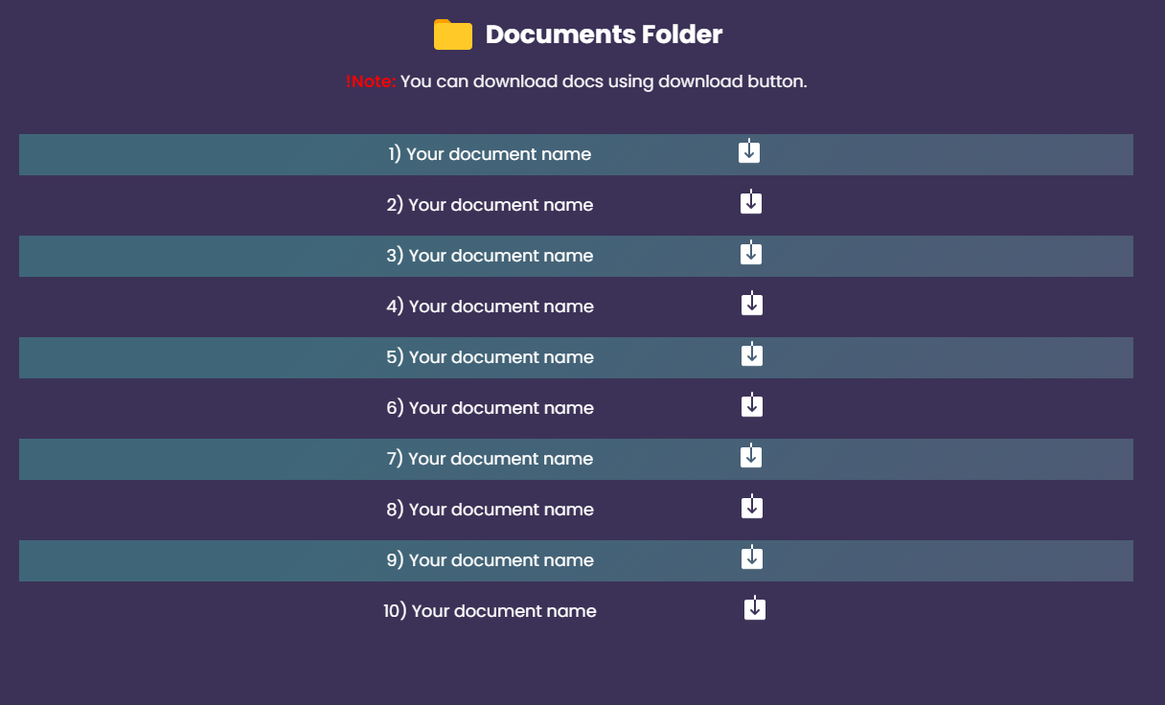
Classes Tab
Documents Folder

Slide 11
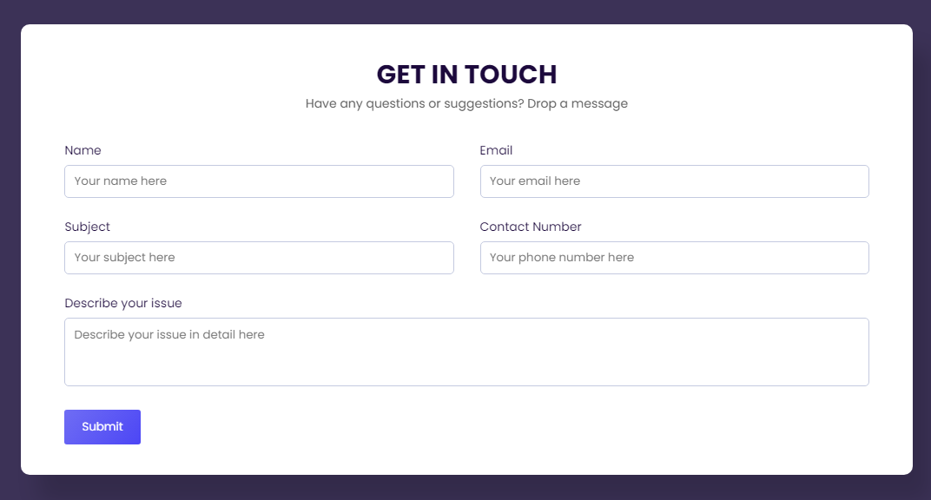
Any Query Tab:

Slide 12
Actual Code and Report:
1. Click here for Code :
Code
2. Click here for Report :
Report

Slide 13
THANK YOU !!!

